Slide 1


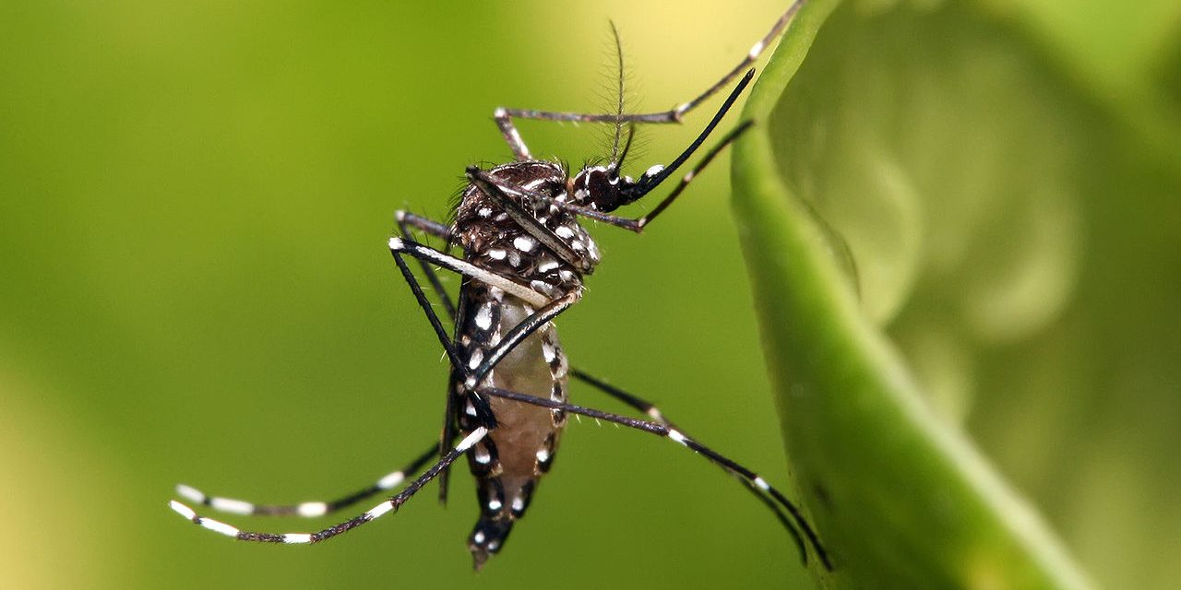
Exploring Dengue and Weather in Bangladesh
Discover the impact of dengue fever in Bangladesh and how unsupervised machine learning can be used to analyze the relationship with weather patterns.
by Aniket Chavan

Slide 2
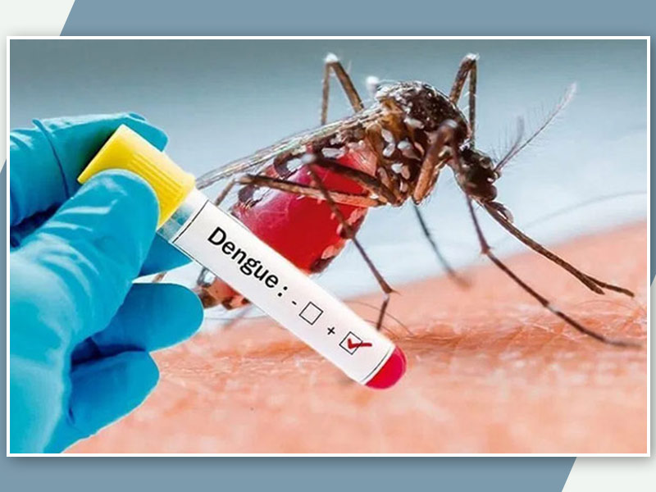
Introduction
Learn about the background of dengue fever incidents in Bangladesh and the significance of understanding its correlation with weather conditions for effective prevention measures.
Dengue is a viral infection transmitted to humans through the bite of infected mosquitoes and is found in tropical and sub-tropical climates worldwide, mostly in urban and semi-urban areas. The primary vectors that transmit the disease are Aedes aegypti mosquitoes and, to a lesser extent, Aedes albopictus.
In Bangladesh it is growing because of the unclean streets, unclean Water bodies, etc.

Slide 3
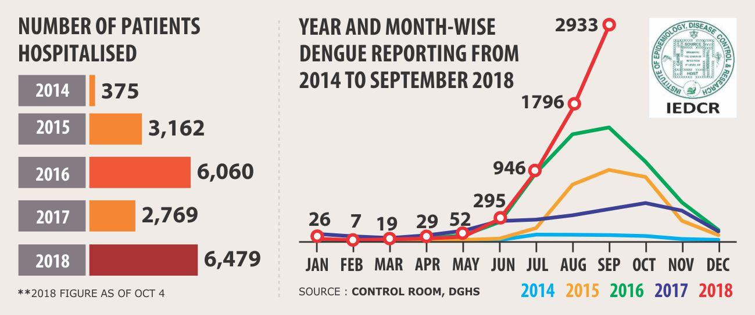
Project Objectives
Explore the purpose of the unsupervised machine learning project, which aims to
identify patterns and trends in dengue incidents based on
weather data, in order to develop early warning systems.
To Analyse the Dengue incident in Bangladesh by using
Kmeans clustering
Hierarchical clustering

Slide 4

Methodology
PROBLEM DEFINATION
DAA COLLECTION
DATA PREPROCESSING
CHECKING NULL VALUES,
FILLING NULL VALUES,
CHECKING FOR OUTLIERS.
EXPLORATORY DATA ANALYSIS.
PLOTTING THE REQUIRED PLOTS
FOR VISULIZATION OF DATA.
Dividing data into clusters.
Removing scores ( Silhouette Score,
Calinski-Harabasz Index, Davies-Bouldin Index )

Slide 5

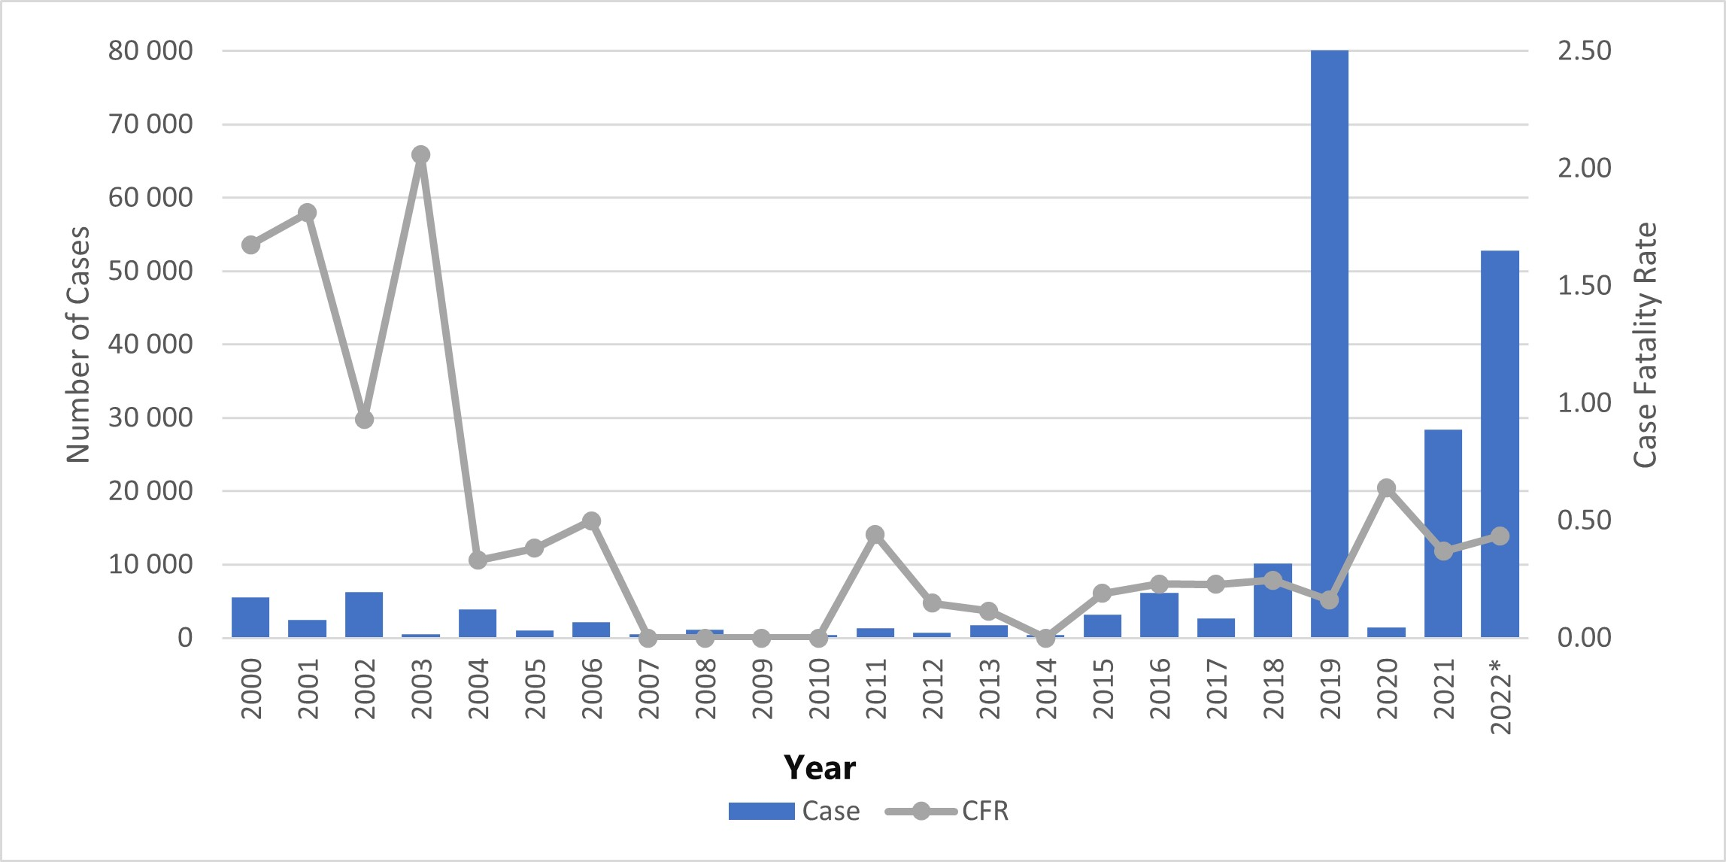
Number of dengue cases and case fatality rates
reported by year in Bangladesh from 1 January 2000 to
20 November 2022.

Slide 6

Result :
RESULTS : | K MEANS | HIERARCHICAL
Silhouette Score: | 0.2947 | 0.2521
Calinski-Harabasz Index: | 43.5085 | 38.80163
"Davies-Bouldin Index: | 0.9638 | 1.5287

Slide 7
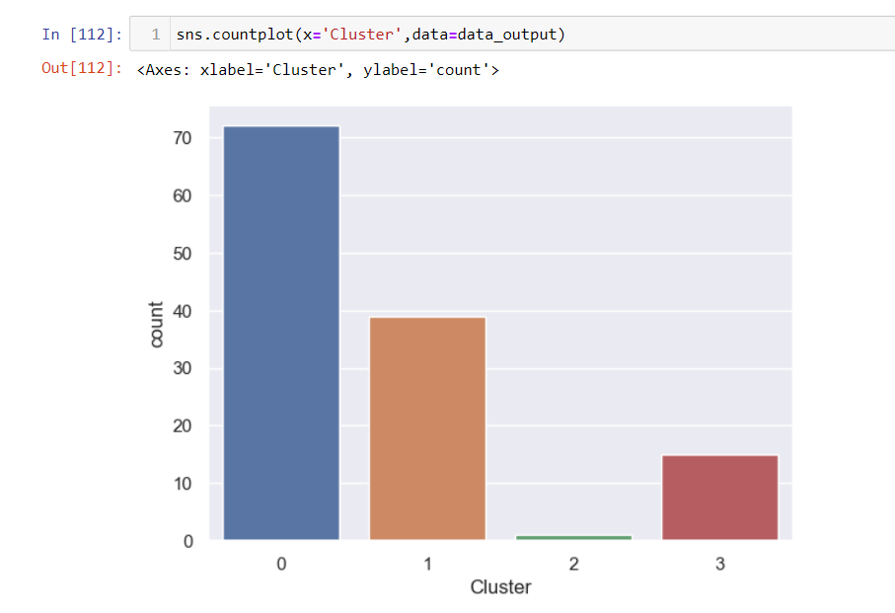

Clusters made :

Slide 8
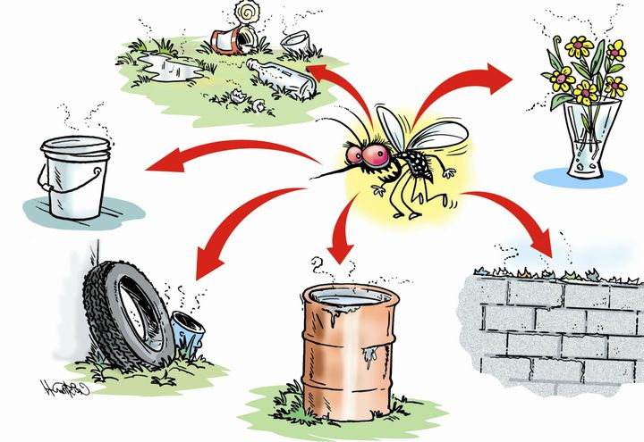
Conclusion and Future Work
We can avoid this disease by maintaining the cleanliness of
water bodies , streets , etc.
Get rid of anything that collects water, like flower pots,
buckets, or old tires. Don't leave water sitting around.
Make sure your gutters and drains are clear so water doesn’t
get stuck, which can attract mosquitoes. You may contact
the local Municipal authorities in order to process the cleaning
in the right way.

